Slide 1

openBIS training
Scientific IT Services
Caterina Barillari, Priyasma Bhoumik

Slide 2
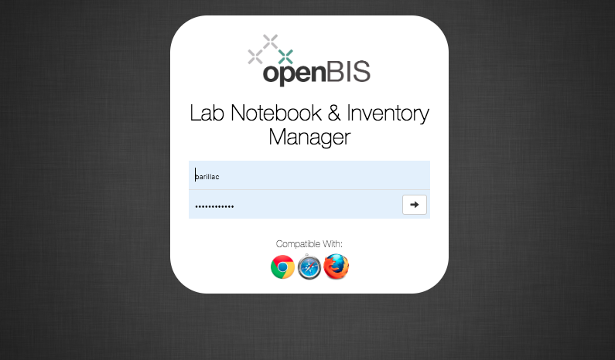
https://openbis-training.ethz.ch/openbis/webapp/eln-lims/?

Slide 3
Overview of training
Introduction to basic openBIS concepts
Hands-on tutorial:
Registration of samples in openBIS Materials Inventory
Registration of protocols in openBIS Methods Inventory
Recording experiments and uploading data in openBIS Lab notebook
Searching the ELN
Freezing entities

Slide 4
Basic openBIS concepts

Slide 5

openBIS: a complete solution for FAIR data management
Description of experiments
Description of processes and data analysis
Electronic Lab Notebook
Inventory Management
Data Management
Store data connected to experimental description
Samples
Materials
Reagents
SOPs
https://openbis.ch

Slide 6
How to use the openBIS Inventory & Lab Notebook
Inventory
Lab Notebook
Shared by all lab members.
Personal space. Can be shared with colleagues/collaborators.
Samples
Experiments
Protocols
Raw data
Processed data
Scripts/ Jupyter notebooks
Results

Slide 7
openBIS Inventory
The default installation has two main folders in the Inventory:
Materials: all samples and materials can be stored in collections in this folder
Methods: all lab protocols (if used!) can be stored in collections in this folder

Slide 8
Organization of openBIS Lab Notebook
In the Lab Notebook part of openBIS, usually each user has a personal Space where to organize Projects and Experiments
An openBIS Experiment is a specific scientific question. The single attempt to answer this question can be modelled as Experimental Steps.
Experimental Steps can be linked to Samples, Protocols, other Experimental Steps
Data (raw, processed, analysed, final results) can be attached to Experiments or Experimental steps in Datasets

Slide 9
openBIS data structure
Folder with access-control
Folder with access-control
Folder with user-defined properties. There can be several types of Experiment/Collection, each defined by different properties. Example: Microscopy experiment, PCR experiment etc.
Entity with user-defined properties. There can be several types of Objects/Samples, each defined by different properties. Examples: Antibody, Chemical, Sensor, Chip, General Protocol, Experimental Step…
Folder for storing data files with user-defined properties. There can be several types of Data Sets, each defined by different properties.
Space
Project
Experiment/Collection
Object/Sample
Data Set
Data Set

Slide 10
openBIS Lab notebook
User
Project 1, Project 2
Experiment 1, Experiment 2
Step1, Step 2
Raw data, analyzed data, code, etc
Raw data, analyzed data, code, etc

Slide 11
Protocols or Experimental Steps?
Protocols are standard procedures used in the lab that need to be shared with all lab members
Every time a given protocol is followed when performing one Experimental Step, the protocol can be linked as parent and the experimental details should be recorded in the Experimental Step itself.
If you do not follow standard procedures, you do not need to use the Inventory of Methods
Protocol
Step 1
Step 2
Experimental Step
Temperature= n °C
Pressure= n Pa

Slide 12
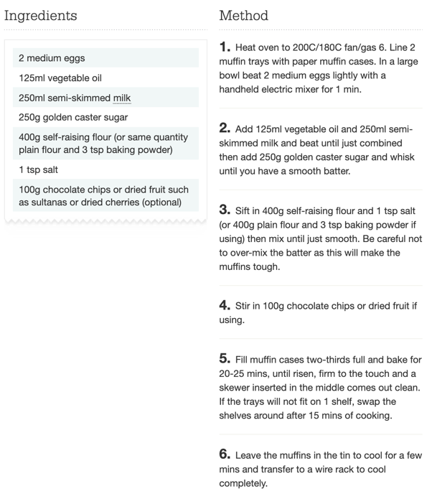
Example
Protocol: muffins recipe
Experimental Step: making muffins
I use 240 ml of whole milk, instead of 250 ml semi-skimmed
I add a teaspoon of sodium bicarbonate
I cook the muffins for 30 mins at 180°C
The protocol gives me directions and defines the steps, like a cooking recipe.
When I perform my experiment I can change some parameters (like I can change some details of the recipe when I make it) and this needs to be recorded in the experimental description.
www.bbcgoodfood.com

Slide 13
Linking objects and datasets
openBIS objects can be linked to other objects and datasets to other datasets with N:N relationship
In openBIS terms, these are “parent-child” relationships
Object
Data Set
Object
Object
Object
Data Set
Data Set
Data Set
Object
Object
Object
Data Set
Data Set
Data Set
Object
Object
Data Set
Data Set

Slide 14
What are “parents” and “children”?
They are a way of connecting entities together.
Examples:
1. One sample is split into several vials and each of them is used for different types of measurements.
Blood Sample
The Blood Sample is parent of the samples in each vial
Vial 1
Vial 2
Vial 3
2. You write a protocol, and want to keep track of the samples used.
Chemical X
Sample Y
Chemical X and Sample Y are parents of the protocol
Protocol

Slide 15
What are “parents” and “children”?
3. You describe an experiment and you want to keep track of the protocol(s) and samples used
Chemical X
Sample Y
Blood sample
Protocol A and Vial 1 are parents of the Lab Experiment 1
Protocol A
Vial 1
Lab Experiment 1
4. You make one experiment in several steps and you want to link each step to the previous one
Lab Experiment 1
Lab Experiment 2
Lab Experiment 3

Slide 16
Roles
Roles | Capabilities
Observer (Space/Project or Instance) | Read-only access to given spaces/projects or to the whole instance.
Space/Project user | Create + edit Object, Experiment. Edit Project .
Space/Project power user | User rights +create Projects . Delete object, experiment, project, datasets.
Space/Project admin | Power user rights+ list roles; create and delete space roles.
Instance admin | Space admin rights + create types. Has access to everything.

Slide 17
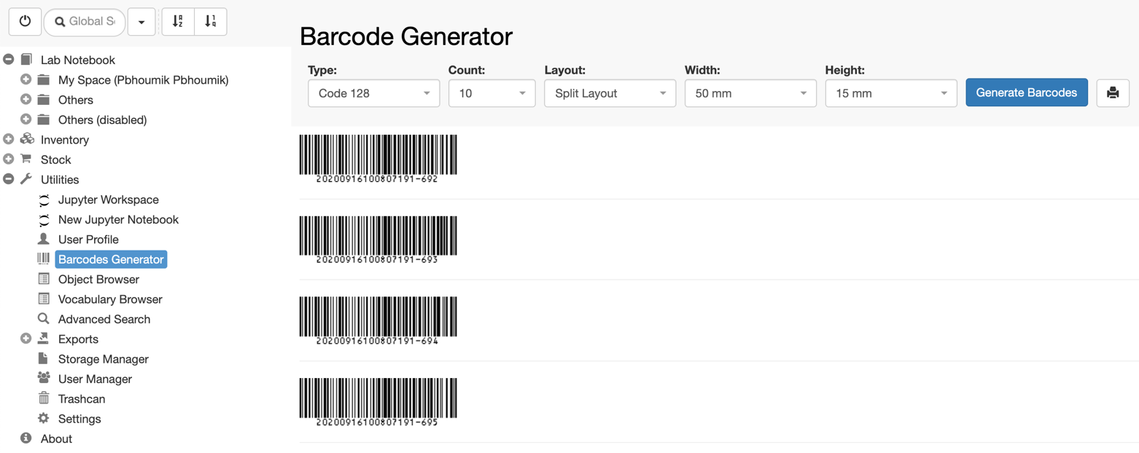
Barcode Generator
Barcodes can be generated & printed after enabling this feature from Settings
It is possible to assign existing barcodes to samples.
Doc: https://openbis.ch/index.php/docs/user-documentation/inventory/barcodes/

Slide 18
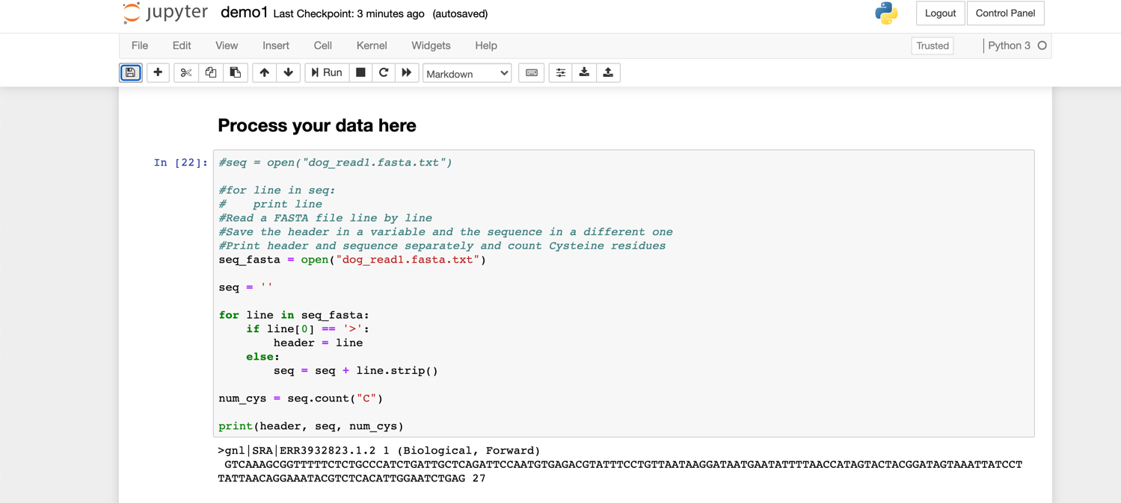
Jupyter Notebooks
Jupyter notebooks can be used locally or via JupyterHub server for downstream data analysis.

Slide 19
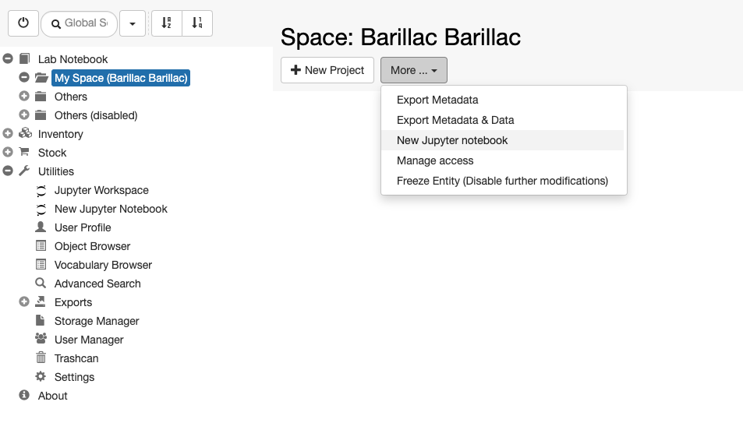
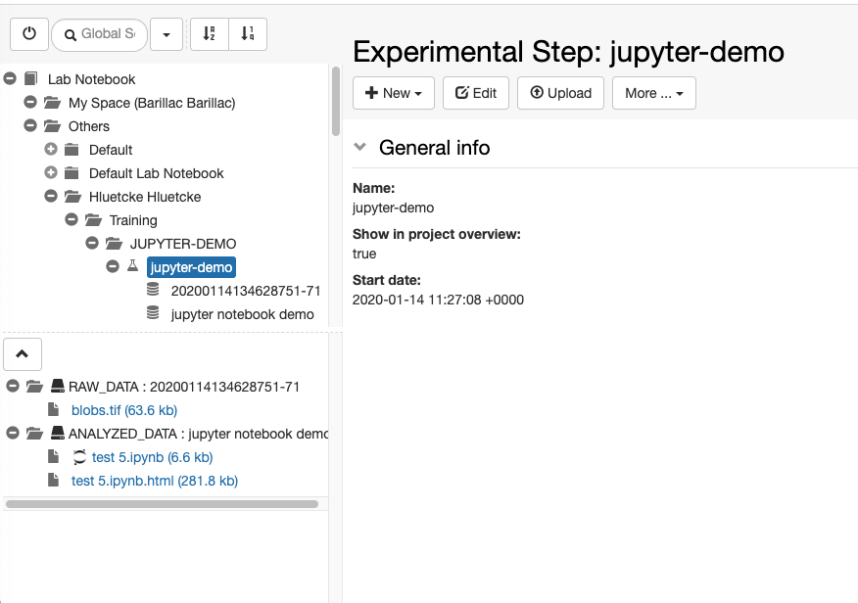
https://pypi.org/project/jupyterlab-openbis/
https://sissource.ethz.ch/hluetcke/matlab-openbis

Slide 20
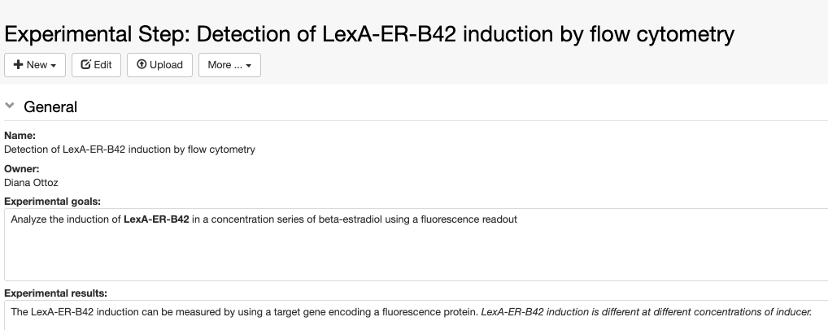
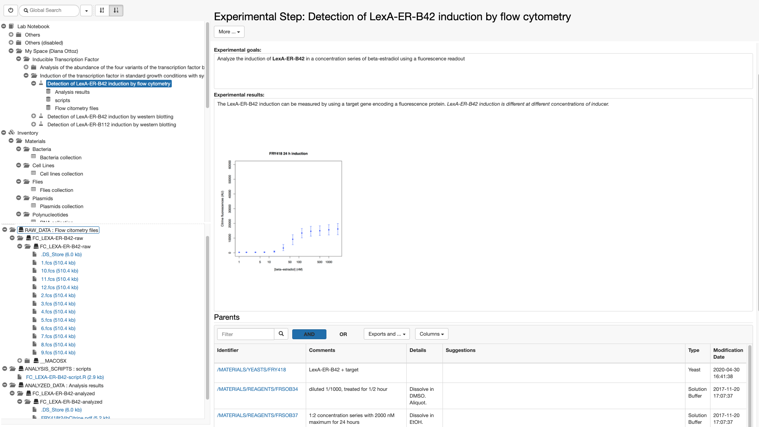
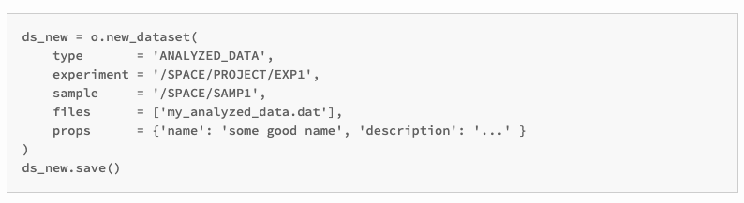

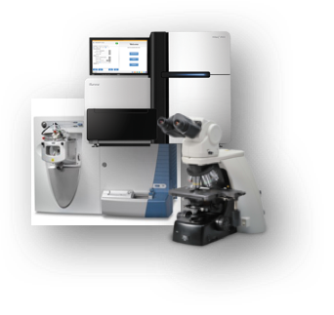
Data ingestion into openBIS
1. Via web interface
2. Via pyBIS
Data files
3. Via dropbox mechanism
manual
automatic
dropbox folder

Slide 21
Overview of openBIS tutorial

Slide 22
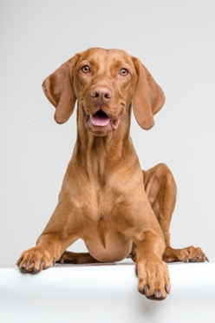
Example: RNA sequencing study of 8 different dog breeds
Goal of the study: understand intra breed genetic variability of dogs with special reference to Beagle dog, since Beagles are used as an animal model for compound testing in the pharma industry.
The eight different dog breeds are as follows:
Beagle
GSD
Golden Retriver
Terrier
King Charles
Poodle
Rottweiler
West Highland White Terrier

Slide 23

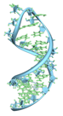

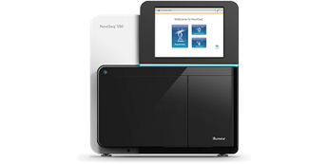
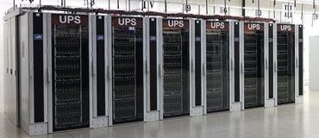
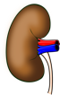
Overview of the study process
By Vossman - Own work, CC BY-SA 3.0, https://commons.wikimedia.org/w/index.php?curid=7115139
Results
RNA extraction from different types of dog tissues
RNA sequencing
Analysis of sequencing data

Slide 24
Overview of the study process
Experiments:
RNA extraction
RNA sequencing
Data analysis
Protocols:
RNA extraction
RNA sequencing
Samples:
Tissues
Chemicals
RNA extracts

Slide 25
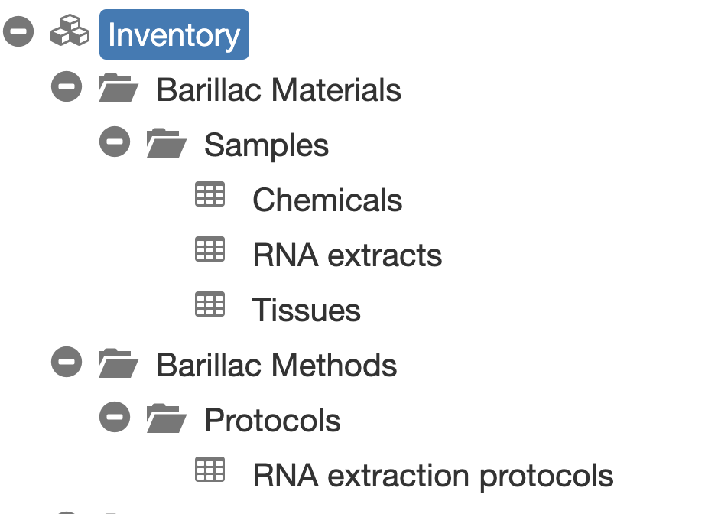
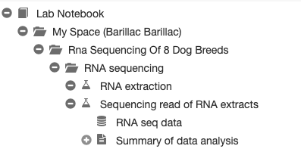
How does the process look like in openBIS?

Slide 26
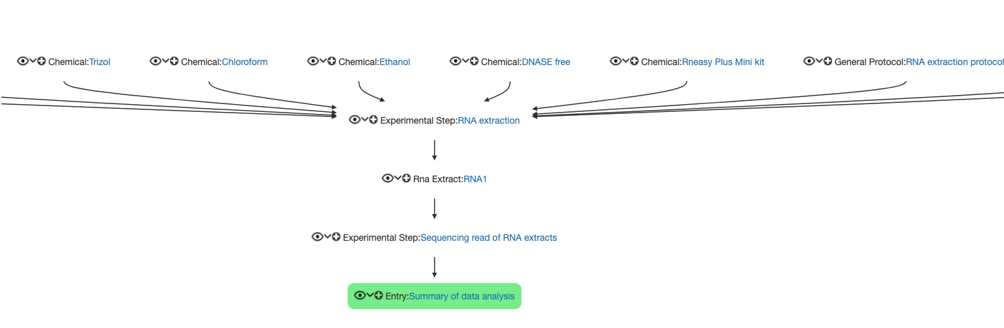
How does the process look like in openBIS?

Slide 27
Management of samples and protocols
We will register a few samples and one protocol in the inventory, covering different topics:
Single sample registration
Batch registration of samples
Batch modification of samples
How to assign storage positions to samples
How to register a standard lab protocol

Slide 28
Lab notebook
Intra breed genetic variability of dogs
RNA analysis of 8 dog breeds
RNA extraction
Sequencing read of RNA extracts
Data analysis
Fasta files
We will create 1 Project, 1 Experiment and 3 Experimental Steps in your personal space.
We will see how we can link samples and protocols stored in the Inventory to the Experimental Step.
We will upload data to the Experimental Step.

Slide 29
Practical sessions

Slide 30
Overview of the study process
By Vossman - Own work, CC BY-SA 3.0, https://commons.wikimedia.org/w/index.php?curid=7115139
Results
RNA extraction from different types of dog tissues
RNA sequencing
Analysis of sequencing data

Slide 31
We start by focusing on the first part of the process
For this part we need to register:
The tissue samples from which we extract RNA
Some chemicals we need for the RNA extraction
The standard protocol we follow for RNA extraction
By Vossman - Own work, CC BY-SA 3.0, https://commons.wikimedia.org/w/index.php?curid=7115139
RNA extraction from different types of dog tissues

Slide 32
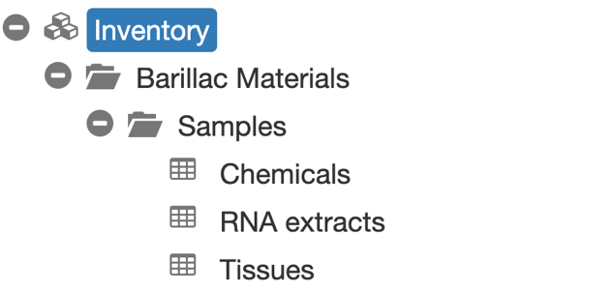

Session 1
Registration and copy of tissue samples: sections 3.1.1 + 3.1.2
10 min

Slide 33
Session 2
Visualization of storage positions in the Storage Manager: section 3.2
To do together

Slide 34
Session 3
Batch registration of chemical samples: section 3.3.1
Deletion of duplicate objects: section 3.3.2
Batch modification of chemical samples: section 3.3.3
15 min

Slide 35
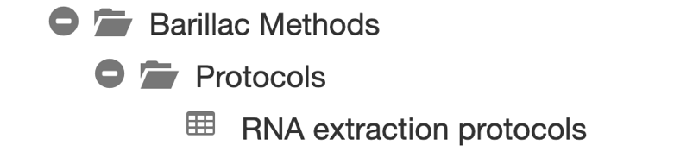
Session 4
Registration of RNA extraction protocol: section 3.4
5 min

Slide 36
Short break

Slide 37
Overview of the study process
By Vossman - Own work, CC BY-SA 3.0, https://commons.wikimedia.org/w/index.php?curid=7115139
Results
RNA extraction from different types of dog tissues
RNA sequencing
Analysis of sequencing data
Step 1
Step 2
Step 3

Slide 38
After having prepared our inventory, we need to describe the experiments we perform in the lab notebook
We want to:
Create the project we are working on. This is the intra breed genetic variability of dogs
Create the “global” experiment, which is the RNA analysis of 8 dog breeds
Create the first step in this experiment, which is the RNA extraction
By Vossman - Own work, CC BY-SA 3.0, https://commons.wikimedia.org/w/index.php?curid=7115139
RNA extraction from different types of dog tissues

Slide 39
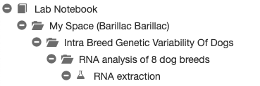
Session 5
Registration of project and experiment: section 4.1, 4.2
Registration of the first Experimental Step: section 4.3.1
Intra breed genetic variability of dogs
RNA analysis of 8 dog breeds
RNA extraction
15 min

Slide 40
Overview of the study process
From the RNA extraction we obtained some RNA extract samples. We will sequence these samples.
Now we want to:
Register the RNA extract samples in the inventory
Record the RNA sequencing experiment on these samples in the lab notebook
By Vossman - Own work, CC BY-SA 3.0, https://commons.wikimedia.org/w/index.php?curid=7115139
RNA extraction from different types of dog tissues
RNA sequencing

Slide 41

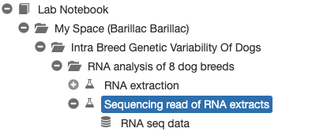
Session 6
Registration of RNA extacts in Inventory: section 4.3.2
Registration of RNA sequencing Experimental Step + data upload: sections 4.3.3, 4.3.4
Intra breed genetic variability of dogs
RNA analysis of 8 dog breeds
RNA extraction
Sequencing read of RNA extracts
10 min
Fasta files

Slide 42
Session 7
Data visualization: sections 4.3.5
Data & metadata exports: 4.3.6
To do together

Slide 43
Overview of the study process
By Vossman - Own work, CC BY-SA 3.0, https://commons.wikimedia.org/w/index.php?curid=7115139
Results
RNA extraction from different types of dog tissues
RNA sequencing
Analysis of sequencing data
After sequencing, we analyze the sequncing data.
We now want to record the analysis step and results in the lab notebook.

Slide 44
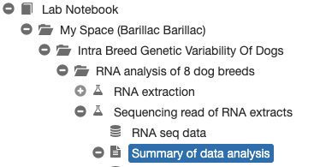
Sessions 8 & 9
Registration of Data Analysis Entry: section 4.3.7
User access rights: section 4.4
Searching the ELN: section 5 (5.1, 5.2)
Intra breed genetic variability of dogs
RNA analysis of 8 dog breeds
RNA extraction
Sequencing read of RNA extracts
Data analysis
10 min
Fasta files

Slide 45
Session 10
Freezing entities: section 6
Jupyter notebooks: section 7
To do together

Slide 46

Paperplane
New service for keeping track of published data offered by SIS:
https://www.paperplane.ethz.ch

Slide 47
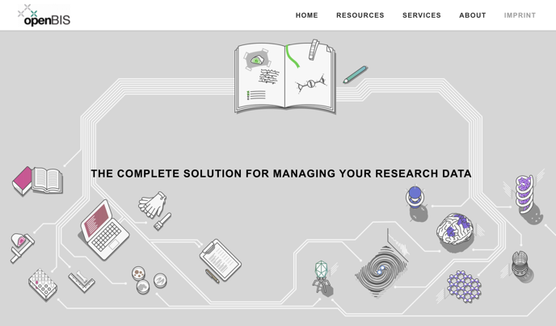
Contacts & useful info
Documentation & video tutorials: https://openbis.ch/
SIS website: https://sis.id.ethz.ch/
Twitter: https://twitter.com/ETH_SIS
SIS helpdesk
openbis-support@id.ethz.ch
Caterina Barillari
caterina.barillari@id.ethz.ch
Priyasma Bhoumik
priyasma.bhoumik@id.ethz.ch

